Slide 1
WinRM vs. OpenSSH
A Showdown for PowerShell Remoting
Paul Broadwith
Notes:
Is WinRM still the go-to protocol for PowerShell remoting, or is it time to switch to OpenSSH? In this presentation, we'll compare the two protocols and explore the pros and cons of each. You'll see demos of how to implement and manage OpenSSH, as well as learn about the support for Windows SSH in popular configuration management tools. Plus, we'll take a look at the future of PowerShell remoting and help you decide which option is best for your needs. Join us for a comprehensive showdown of WinRM and OpenSSH!

Slide 2

Many thanks to our sponsors:

Slide 3




Paul Broadwith
Technical Engineering Manager, Chocolatey Software Inc.
Glasgow, Scotland
30 years in IT in many different sectors

Slide 4


Slide 5
Q&A
15 minutes

Slide 6
Agenda
Look at both OpenSSH and WinRM.
Demo of configuring OpenSSH and WinRM.
Configuration Manager support for SSH on Windows.
Which to choose?!?!?
What does the future of OpenSSH hold?

Slide 7
Who and What is WinRM?

Slide 8
What is WinRM?
Introduced in Windows Vista and Server 2008.
Built on top of WMI.
Uses SOAP over HTTP/HTTPS
Tightly coupled with PowerShell.
WinRM is a standardized way to communicate with and manage Windows-based systems.

Slide 9
A Brief History of WinRM
2005: Microsoft announced WinRM.
2006: PowerShell 1.0 with WinRM support.
2008: WinRM built-in to Vista and Server 2008.
2009: Windows 7 was released; increased adoption.
2012: Scalability, security and performance enhancements added.

Slide 10
WinRM: Good and Bad
Native support for Windows Vista / Server 2008 onwards.
Supports Kerberos and NTLM.
Tightly coupled with PowerShell.
Not cross-platform.
Can be complex to setup, particularly with certificate based authentication.
Heavyweight protocol compared to SSH.

Slide 11
The Old Kid in the New Town
What is OpenSSH?

Slide 12
What is SSH?
SSH (v1) was created by Tatu Ylönen in 1995.
SSH v2 specification published by IETF in 2006.
SSH v2 is a rewrite of the SSH protocol and uses different auth / encryption algorithms.
SSH enables user authentication methods based on public key cryptographic algorithms.
Notes:
SSH v1 has numerous vulnerabilities and is not under active development.
SSH v2 supports AES, Blowfish, 3DES, CAST-128 and RC4 encryption algorithms.
SSH v2 added sftp support.
See https://www.techtarget.com/searchsecurity/tip/An-introduction-to-SSH2

Slide 13
What is OpenSSH?
Open-source implementation of SSH v2.
Created by the OpenSSH project due licensing issues with Tatu’s SSH client.
Fork of OpenBSD’s OpenSSH.
Microsoft’s OpenSSH is a fork of OpenSSH.

Slide 14
A Brief History of Windows OpenSSH
Oct 2015: First pre-release was made.
Jul 2018: First production release, 7.7.2.0.
Apr 2023: Latest release is 9.2.2.0.
Notes:
First release in October 2015 surprised me.

Slide 15
OpenSSH: Good & Bad
Cross-platform. One tool.
SSH is a widely supported standard.
Huge user base ensuring continued development.
More features! scp, sftp, tunnelling.
Not OOB.
Born in Unix-land so may be unfamiliar for Windows admins.
Lack of support in Windows.
PowerShell Subsystem required.
Notes:
Cross-platform compatibility: OpenSSH is widely supported on almost every operating system. This allows you to manage a heterogeneous environment using one tool.
OpenSSH has become a de facto standard for secure remote access and administration. It has a huge user base and extensive community support, which ensures its stability and continuous development.
Secure and encrypted communication: OpenSSH provides strong encryption and authentication mechanisms, ensuring secure communication between the client and server. It protects sensitive data, passwords, and commands exchanged during remote sessions.
OpenSSH has additional features such as secure file transfer (SFTP) and secure port forwarding (tunneling). It also supports key-based authentication, agent forwarding.
Up to date version of OpenSSH is not available out of the box. Need to install

Slide 16
Demos
We love Demos!
Notes:
Setting up WinRM and OpenSSH.

Slide 17
Configuration Management Support

Slide 18







Configuration Managers
PowerShell DSC
Notes:
Ansible: https://docs.ansible.com/ansible/latest/os_guide/windows_setup.html#windows-ssh-setup
Puppet: ssh module https://forge.puppet.com/modules/ploperations/ssh/readme

Slide 19
The Choice?

Slide 20
Which to Choose?
WinRM!
WinRM is native to Windows.
Heavyweight.
Tightly coupled with PowerShell.
OpenSSH!
Additional configuration.
Lightweight.
Limited PowerShell coupling.
No JEA.

Slide 21
WinRM

Slide 22
The Future?

Slide 23
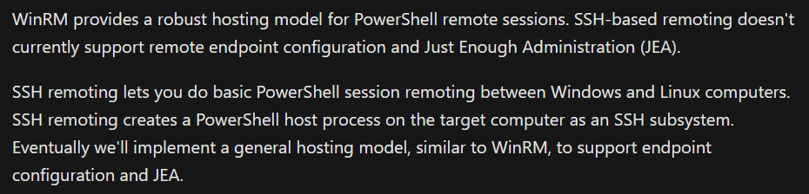



https://learn.microsoft.com/en-us/powershell/scripting/learn/remoting/ssh-remoting-in-powershell-core#overview

Slide 24



blog.pauby.com
@pauby@mastodon.social
github.com/pauby
pau.by/talks
pau.by/linkedin

